Slide 1
Parallel Processing

Slide 2
Parallel Processing :
Parallel processing can be described as a class of techniques which enables the system to achieve simultaneous data-processing tasks to increase the computational speed of a computer system.
A parallel processing system can carry out simultaneous data-processing to achieve faster execution time. For instance, while an instruction is being processed in the ALU component of the CPU, the next instruction can be read from memory.

Slide 3
CONTINUED…
The primary purpose of parallel processing is to enhance the computer processing capability and increase its throughput, i.e. the amount of processing that can be accomplished during a given interval of time.
A parallel processing system can be achieved by having a multiplicity of functional units that perform identical or different operations simultaneously. The data can be distributed among various multiple functional units.

Slide 4
PARALLEL PROCESSING : EXAMPLE
The following diagram shows one possible way of separating the execution unit into eight functional units operating in parallel.
The operation performed in each functional unit is indicated in each block if the diagram:

Slide 5
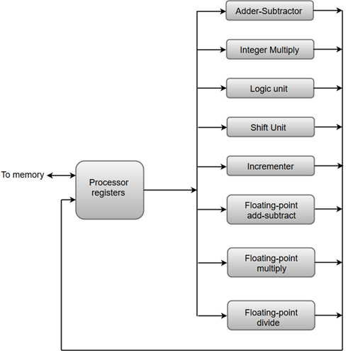

Slide 6
CONTINUED…
The adder and integer multiplier performs the arithmetic operation with integer numbers.
The floating-point operations are separated into three circuits operating in parallel.
The logic, shift, and increment operations can be performed concurrently on different data. All units are independent of each other, so one number can be shifted while another number is being incremented.

Slide 7
Advantages of parallel processing:
Parallel processing systems has capability to perform multiple task simultaneously.
Parallel processing systems offer high performance.
Parallel processing architecture reduces the computer costs.
Parallel processing architecture offers sustained productivity.

Slide 8
CONTINUED…
So along with the high performance, Parallel processing systems also helps in lower computer costs and sustained productivity.
Parallel computers architecture are categorized as:
Pipelined computers
Array processors
Multiprocessor systems

Slide 9
Flynn's classification :
As computer technology has evolved, and as the cost of computer hardware has dropped, computer designers have sought more and more opportunities for parallelism, usual to enhance performance and, in some cases, to increase availability.
The taxonomy first introduced by Flynn is still the most common way of categorizing systems with parallel processing capability. Flynn proposed the following categories of computer system:

Slide 10
Flynn's classification :
Flynn's classification divides computers into four major groups that are:
Single instruction stream, single data stream (SISD)
Single instruction stream, multiple data stream (SIMD)
Multiple instruction stream, single data stream (MISD)
Multiple instruction stream, multiple data stream (MIMD)

Slide 11
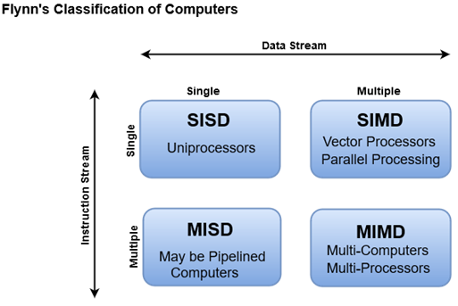

Slide 12
Single instruction stream, single data stream (SISD)
An SISD computing system is a uniprocessor machine which is capable of executing a single instruction, operating on a single data stream.
In SISD, machine instructions are processed in a sequential manner and computers adopting this model are popularly called sequential computers.
Most conventional computers have SISD architecture. All the instructions and data to be processed have to be stored in primary memory.

Slide 13
Single-instruction, multiple-data (SIMD) systems –
An SIMD system is a multiprocessor machine capable of executing the same instruction on all the CPUs but operating on different data streams.
Machines based on an SIMD model are well suited to scientific computing since they involve lots of vector and matrix operations.
So that the information can be passed to all the processing elements (PEs) organized data elements of vectors can be divided into multiple sets(N-sets for N PE systems) and each PE can process one data set.

Slide 14
Single-instruction, multiple-data (SIMD) systems –
Single Instruction, Multiple Data (SIMD) system: A single machine instruction controls the simultaneous execution of a number of processing elements on a lockstep basis.
Each processing element has an associated data memory, so that each instruction is executed on a different set of data by the different processors. Vector and array processors fall into this category

Slide 15
Multiple-instruction, single-data (MISD) systems –
A sequence of data is transmitted to a set of processors, each of which executes a different instruction sequence. This structure has never been implemented.
An MISD computing system is a multiprocessor machine capable of executing different instructions on different PEs but all of them operating on the same dataset .

Slide 16
Multiple-instruction, single-data (MISD) systems –
The system performs different operations on the same data set. Machines built using the MISD model are not useful in most of the application, a few machines are built, but none of them are available commercially.

Slide 17
Multiple-instruction, multiple-data (MIMD) systems –
An MIMD system is a multiprocessor machine which is capable of executing multiple instructions on multiple data sets.
Multiple Instruction, Multiple Data (MIMD) system: A set of processors simultaneously execute different instruction sequences on different data sets.
Symmetric multiprocessor (SMPs), cluster.s, and Nonuniform memory access (NUMA) systems fits into this category.

Slide 18


